Slide 1
Business Report
Absenteeism at work

Slide 2
AGENDA
Data Exploration
Insights
Recommendations
Data Modeling
Q/A

Slide 3
Exploratory Data Anlysis

Slide 6
Resources Used – Check Online
Github Project Link:
Tableau Project Link: https://public.tableau.com/views/PeojectAboutAbsenteeismAtWork/_Smoking?:language=en-US&publish=yes&:display_count=n&:origin=viz_share_link

Slide 7
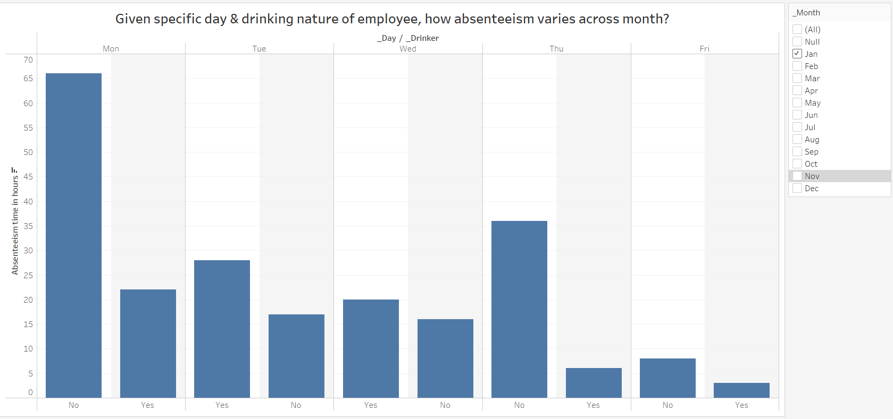
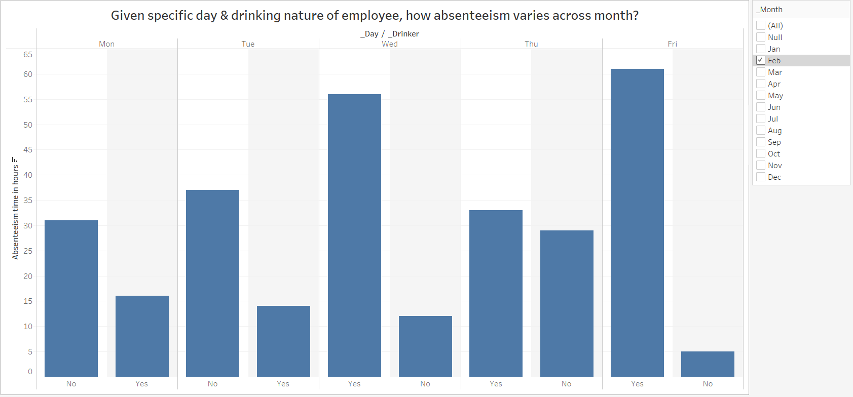
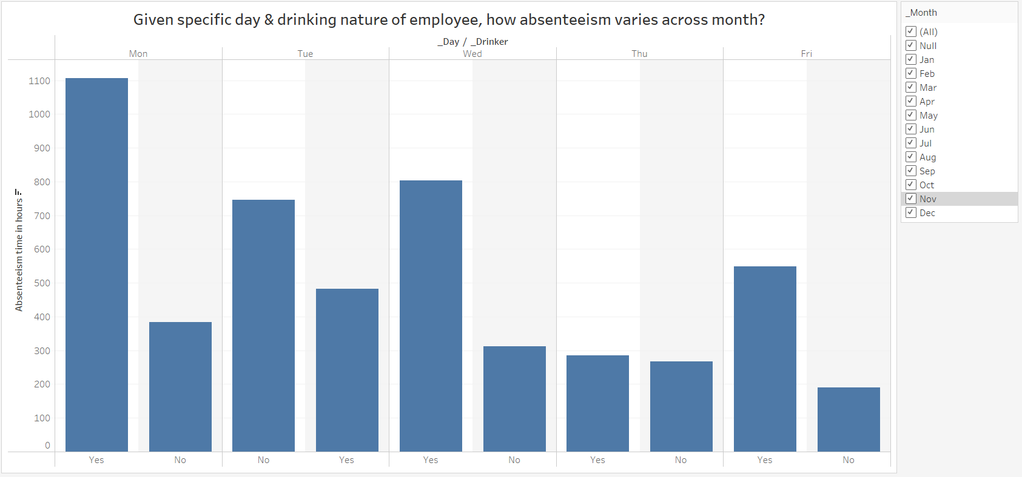
Given specific day & drinking nature of employee, how absenteeism varies across month?

